Slide 1

Stockify
Model for Estimating Stock Performance
By: Abdullah salau

Slide 2
Brief Overview
Predicting Stock Profitability
Binary Classification
Algorithm processing and preprocessing
Regression Analysis on nominal Variable
Notes:
Stockify is a program containing estimation models designed to predict whether or not a particular stock is worth buying (ie. its value will increase) at the end of a year based on numerous financial indicators that act as the model’s independent variables. The program includes multiple binary classification algorithms for prediction, but also showcases algorithm performance results to determine which model works best with an existing dataset that includes stock information from 2014-2018.
Stockify also contains models to predict one of the nominal financial indicators included in the dataset. Similar to the binary classification problem, Stockify also includes the algorithm performance results for each model designed to predict the nominal financial indicator to determine the highest performing algorithm.

Slide 3
The Datasets
5 Datasets (2014-2018)
225 columns (1 ID column, 223 Predictors, 1 Class Variable)
3808 records

Slide 4
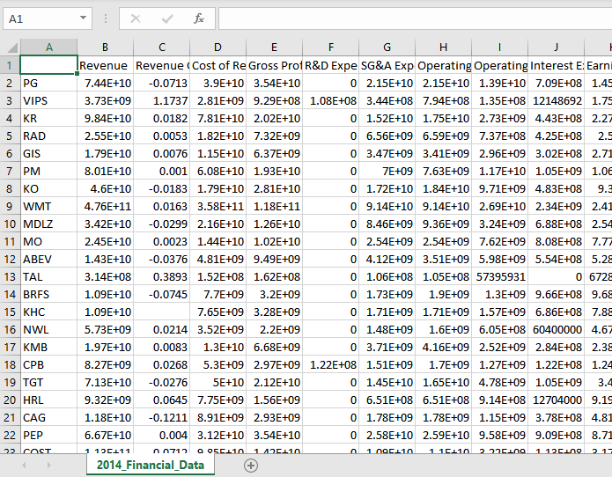
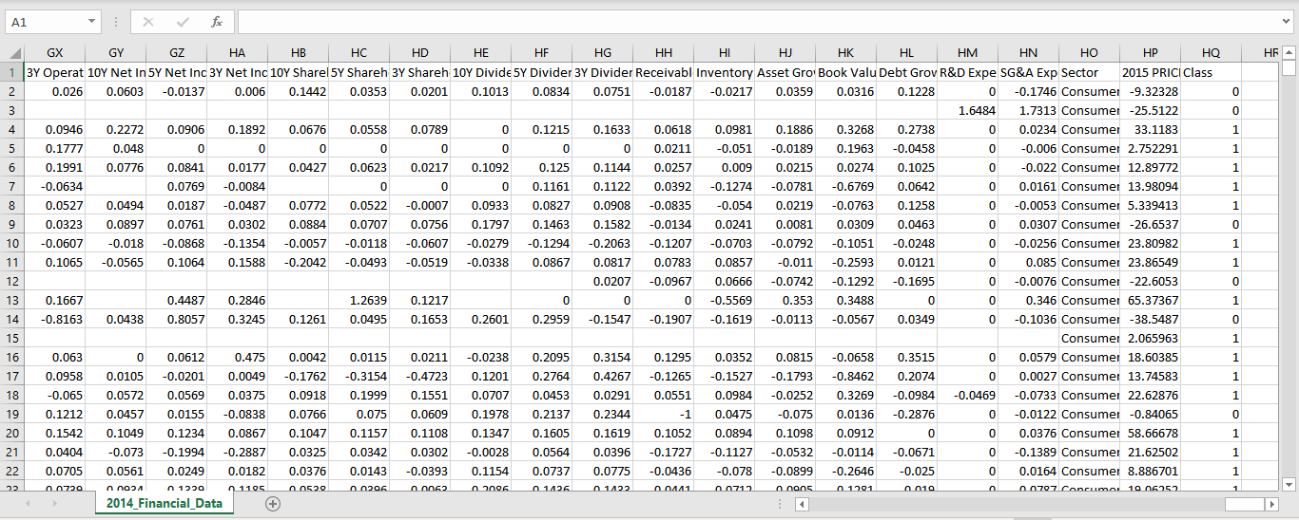
Notes:
The last column of the dataset represent the class of each stock, where:
if the value of a stock increases during 2015, then class=1;
if the value of a stock decreases during 2015, then class=0.

Slide 5
Cleaning the Dataset

Slide 6
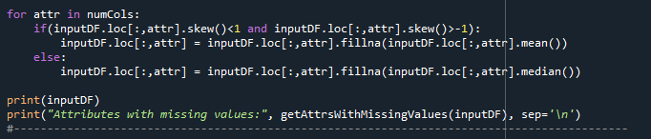
Handling Class and Label Column
Handling Problematic Columns
Handling Missing Values
Notes:
Problematic Columns- Columns that had no values except 1 or 2, columns with the same values
Missing Values- If the skewness is between -1 and 1, the data are fairly symmetrical. Therefore, we use mean to fill in missing values
Otherwise, use median

Slide 7
Handling Categorical Variable (Sector)
Notes:
We use Built in function for One Hot Encoding (pd.get_dummies

Slide 8
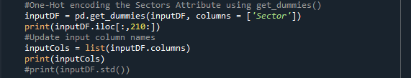

Slide 9
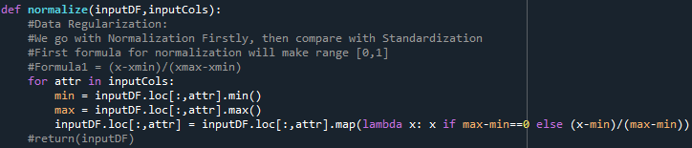
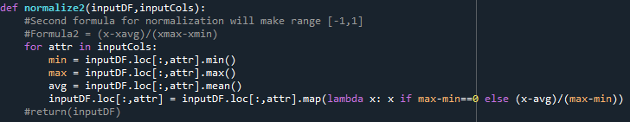


Data Regularization
Two techniques for Normalization
$x_{new}=\frac{x−x_{min}}{x_{max}−x_{min}}$ and $x_{new}=\frac{x−x_{avg}}{x_{max}−x_{min}}$
Standardization
$$x_{new}=\frac{x−x_{avg}}{x_{std}}$$
$$x_{std}=\sqrt{\frac{1}{m}\sum_{i=1}^{m}{{\left(x^{(i)}−x_{avg}\right)}^{2}}}$$
Notes:
After building logistic model, we test each, no difference in performance results

Slide 10
Logistic Model

Slide 11
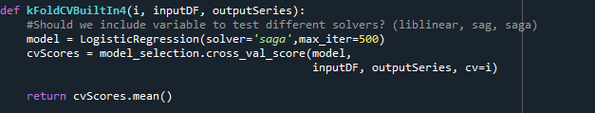
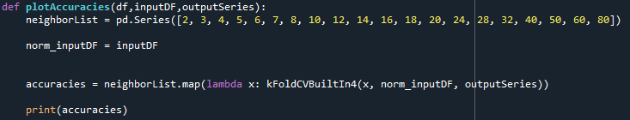
Building LogisticRegression object and running K-Cross Fold Validations:
Notes:
Solver = ‘saga’
Accuracies for different K

Slide 12
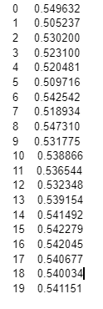
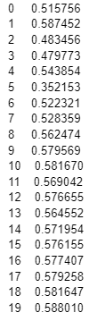
Comparisons (Before Multicollinearity and Feature Selection)
Unprocessed DataSet
Processed dataset

Slide 13
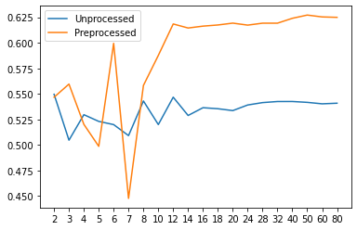
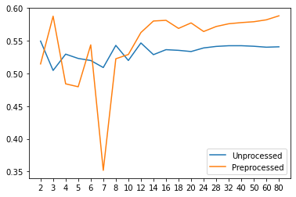

Slide 14
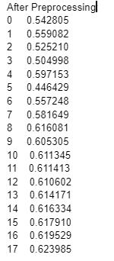
Comparisons (After Multicollinearity and Feature Selection)
Unprocessed DataSet
Processed dataset

Slide 16
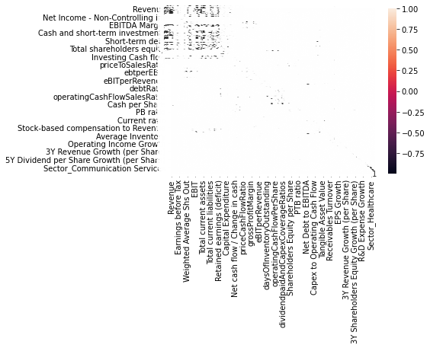
Comparison Matrix (No Feature Selection)

Slide 17
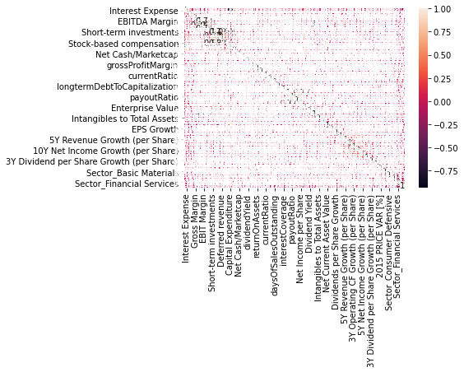
Comparison Matrix (Multicollinearity, then selectKBest(k=50))

Slide 18
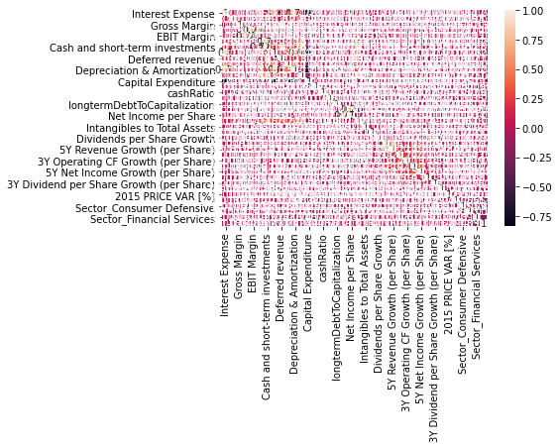
Comparison Matrix (selectKBest(k=50), then Multicollinearity)

Slide 19
Thank you!

